Slide 1
Data and Computer Communications
Chapter 1
Introduction

Slide 2

A Communications Model
Source
generates data to be transmitted
Transmitter
Converts data into transmittable signals
Transmission System
Carries data
Receiver
Converts received signal into data
Destination
Takes incoming data

Slide 3
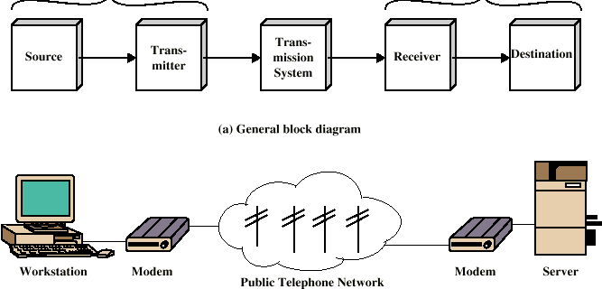
Simplified Communications Model - Diagram

Slide 4
Key Communications Tasks
Transmission System Utilization
Interfacing
Signal Generation
Synchronization
Exchange Management
Error detection and correction
Addressing and routing
Recovery
Message formatting
Security
Network Management

Slide 5
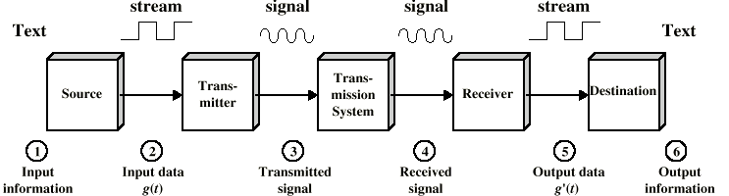
Simplified Data Communications Model

Slide 6
Networking
Point to point communication not usually practical
Devices are too far apart
Large set of devices would need impractical number of connections
Solution is a communications network

Slide 7
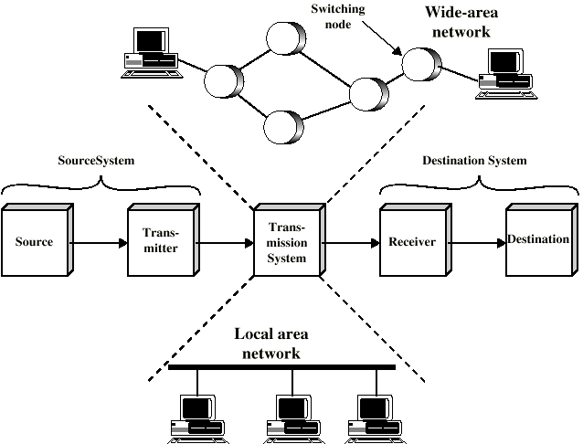
Simplified Network Model

Slide 8
Wide Area Networks
Large geographical area
Crossing public rights of way
Rely in part on common carrier circuits
Alternative technologies
Circuit switching
Packet switching
Frame relay
Asynchronous Transfer Mode (ATM)

Slide 9
Circuit Switching
Dedicated communications path established for the duration of the conversation
e.g. telephone network

Slide 10
Packet Switching
Data sent out of sequence
Small chunks (packets) of data at a time
Packets passed from node to node between source and destination
Used for terminal to computer and computer to computer communications

Slide 11
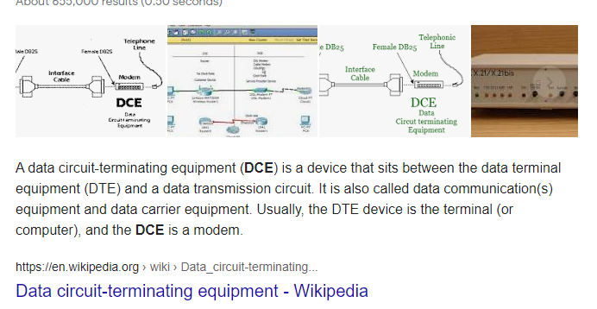
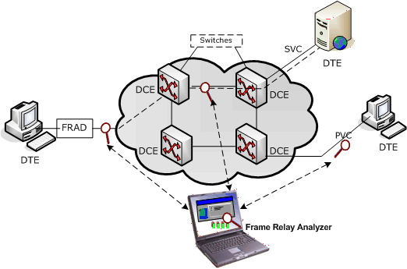
Frame Relay
Packet switching systems have large overheads to compensate for errors
Modern systems are more reliable
Errors can be caught in end system

Slide 12
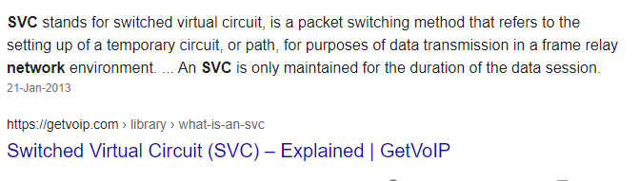
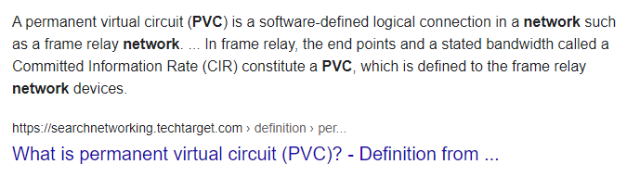

Slide 13
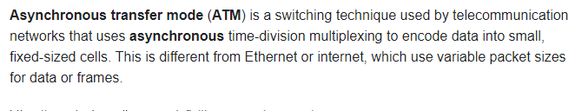
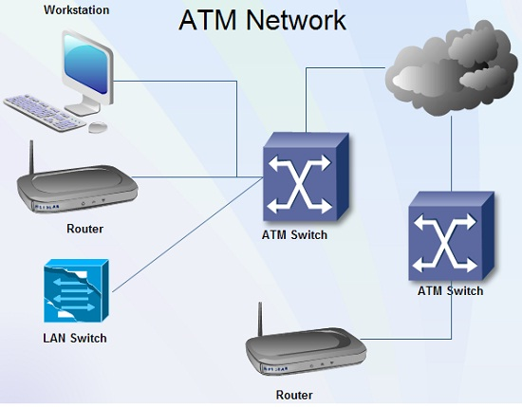
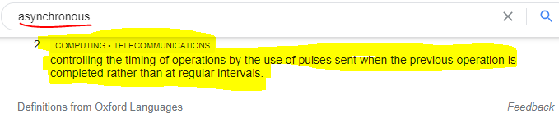
Asynchronous Transfer Mode
ATM
Evolution of frame relay
Little overhead for error control
Fixed packet (called cell) length
Anything from 10Mbps to 1Gbps
Constant data rate using packet switching technique

Slide 14
Local Area Networks
Smaller scope
Building or small campus
Usually owned by same organization as attached devices
Data rates much higher
Usually broadcast systems
Now some switched systems and ATM are being introduced

Slide 15
Protocols
Used for communications between entities in a system
Must speak the same language
Entities
User applications
e-mail facilities
terminals
Systems
Computer
Terminal
Remote sensor

Slide 16
Key Elements of a Protocol
Syntax
Data formats
Signal levels
Semantics
Control information
Error handling
Timing
Speed matching
Sequencing

Slide 17
Protocol Architecture
Task of communication broken up into modules
For example file transfer could use three modules
File transfer application
Communication service unit
Network access unit

Slide 18
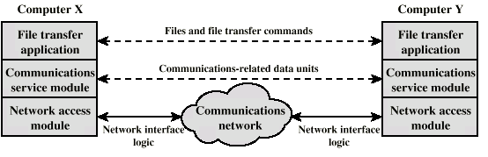
Simplified File Transfer Architecture

Slide 19
A Three Layer Model
Network Access Layer
Transport Layer
Application Layer

Slide 20
Network Access Layer
Exchange of data between the computer and the network
Sending computer provides address of destination
May invoke levels of service
Dependent on type of network used (LAN, packet switched etc.)

Slide 21
Transport Layer
Reliable data exchange
Independent of network being used
Independent of application

Slide 22
Application Layer
Support for different user applications
e.g. e-mail, file transfer

